Slide 1
CHAPTER - 1
Introduction

Slide 2
Reference Books
Textbooks:
1. Data Communications & Networking.
Behrouz A. Forouzan
2. Data and Computer Communications.
William Stallings
2

Slide 3
1.1 Data Communications
When we communicate, we are sharing information.
This sharing can be local or remote.
Between individuals, local communication usually occurs face to face, while remote communication takes place over distance.
3

Slide 4
Cont.
Data communications are the exchange of data between two devices via some form of transmission medium such as a wire cable.
For data communications to occur, the communicating devices must be part of a communication system made up of a combination of hardware (physical equipment) and software (programs).
4

Slide 5
Cont.
The effectiveness of a data communications system depends on four fundamental characteristics:
(1). Delivery, (2). Accuracy, (3). Timeliness, (4). Jitter.
Delivery:
The system must deliver data to the correct destination. Data must be received by the intended device or user and only by that device or user.
Accuracy:
The system must deliver the data accurately. Data that have been altered in transmission and left uncorrected are unusable.
5

Slide 6
Cont.
Timeliness:
The system must deliver data in a timely manner. Data delivered late are useless.
Jitter:
Jitter refers to the variation in the packet arrival time. It is the uneven delay in the delivery of audio or video packets.
For example, let us assume that video packets are sent every 30 ms. If some of the packets arrive with 30-ms delay and others with 40-ms delay, an uneven quality in the video is the result.
6

Slide 7
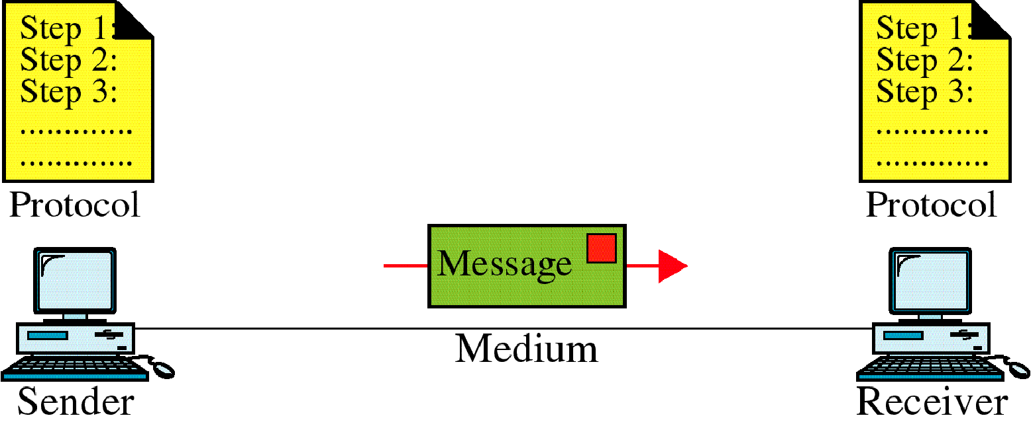
Components
A data communications system has five components.
7

Slide 8
Cont.
Message:
The message is the information (data) to be communicated. Popular forms of information include text, numbers, pictures, audio, and video.
Sender:
The sender is the device that sends the data message. It can be a computer, workstation, telephone handset, video camera, and so on.
Receiver:
The receiver is the device that receives the message. It can be a computer, workstation, telephone handset, television, and so on.
8

Slide 9
Cont.
Transmission medium:
The transmission medium is the physical path by which a message travels from sender to receiver. Some examples of transmission media include twisted-pair wire, coaxial cable, fiber-optic cable, and radio waves.
Protocol:
A protocol is a set of rules that govern data communications. It represents an agreement between the communicating devices. Without a protocol, two devices may be connected but not communicating, just as a person speaking French cannot be understood by a person who speaks only Japanese.
9

Slide 10
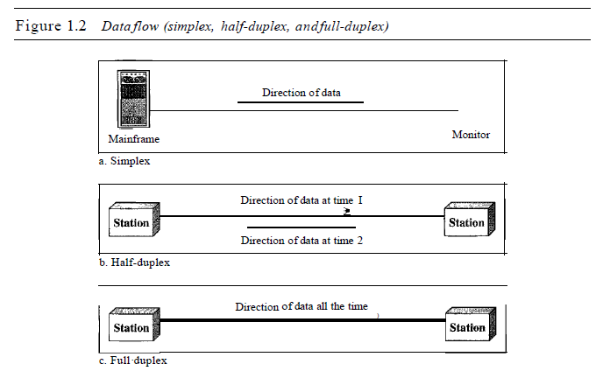
Data Flow
Communication between two devices can be simplex, half-duplex, or full-duplex.
10

Slide 11
Simplex
In simplex mode, the communication is unidirectional, as on a one-way street. Only one of the two devices on a link can transmit; the other can only receive.
Keyboards and traditional monitors are examples of simplex devices. The keyboard can only introduce input; the monitor can only accept output.
11

Slide 12
Half-Duplex
In half-duplex mode, each station can both transmit and receive, but not at the same time. When one device is sending, the other can only receive, and vice versa.
The half-duplex mode is like a one-lane road with traffic allowed in both directions. When cars are traveling in one direction, cars going the other way must wait.
For example, Walkie-talkies and CB (citizens band) radios are both half-duplex systems.
12

Slide 13
Full-Duplex
In full-duplex mode (also called duplex), both stations can transmit and receive simultaneously.
The full-duplex mode is like a two-way street with traffic flowing in both directions at the same time.
One common example of full-duplex communication is the telephone network. When two people are communicating by a telephone line, both can talk and listen at the same time.
13

Slide 14
1.2 Networks
A network is a set of devices (often referred to as nodes) connected by communication links.
A node can be a computer, printer, or any other device capable of sending and/or receiving data generated by other nodes on the network.
14

Slide 15
Distributed Processing
Most networks use distributed processing, in which a task is divided among multiple computers.
Instead of one single large machine being responsible for all aspects of a process, separate computers (usually a personal computer or workstation) handle a subset.
15

Slide 16
Network Criteria
A network must be able to meet a certain number of criteria. The most important of these are performance, reliability, and security.
Performance:
Performance can be measured in many ways, including transit time and response time.
Transit time is the amount of time required for a message to travel from one device to another.
Response time is the elapsed time between an request and a response.
The performance of a network depends on a number of factors, including the number of users, the type of transmission medium, the capabilities of the connected hardware, and the efficiency of the software.
16

Slide 17
Cont.
Reliability:
In addition to accuracy of delivery, network reliability is measured by the frequency of failure, the time it takes a link to recover from a failure, and the network's robustness in a catastrophe.
Security:
Network security issues include protecting data from unauthorized access, protecting data from damage and development, and implementing policies and procedures for recovery from breaches and data losses.
17

Slide 18
Physical Structures
Before discussing networks, we need to define some network attributes.
Type of Connection
A network is two or more devices connected through links. A link is a communications pathway that transfers data from one device to another.
There are two possible types of connections:
(1). Point-to-point and
(2). Multipoint.
18

Slide 19
Point-to-Point
A point-to-point connection provides a dedicated link between two devices.
The entire capacity of the link is reserved for transmission between those two devices.
When you change television channels by infrared remote control, you are establishing a point-to-point connection between the remote control and the television's control system.
19

Slide 20
Multipoint
A multipoint (also called multidrop) connection is one in which more than two specific devices share a single link.
In a multipoint environment, the capacity of the channel is shared, either spatially or temporally.
If several devices can use the link simultaneously, it is a spatially shared connection. If users must take turns, it is a timeshared connection.
20

Slide 21
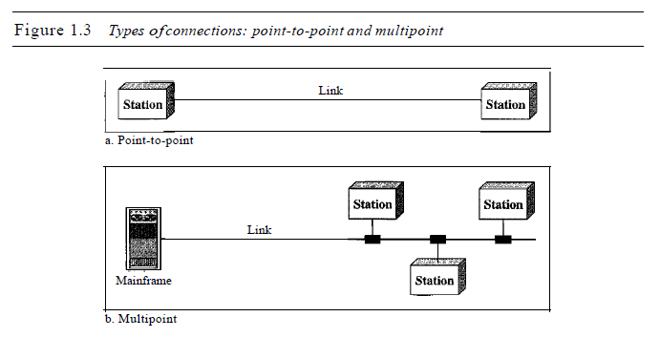
Cont.
21

Slide 22
Physical Topology
The term physical topology refers to the way in which a network is laid out physically.:
Two or more devices connect to a link; two or more links form a topology.
The topology of a network is the geometric representation of the relationship of all the links and linking devices (usually called nodes) to one another.
There are four basic topologies possible: mesh, star, bus, and ring.
22

Slide 23
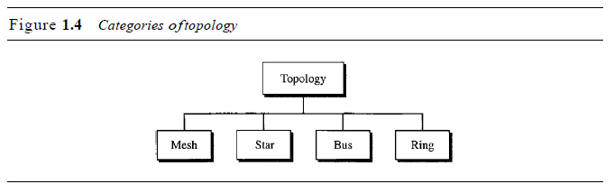
H.W
23

Slide 24
1.4 Protocols and Standards
Protocol:
A protocol is a set of rules that govern data communications.
A protocol defines what is communicated, how it is communicated, and when it is communicated.
The key elements of a protocol are syntax, semantics, and timing.
24

Slide 25
Cont.
Syntax:
The term syntax refers to the structure or format of the data, meaning the order in which they are presented.
For example, a simple protocol might expect the first 8 bits of data to be the address of the sender, the second 8 bits to be the address of the receiver, and the rest of the stream to be the message itself.
25

Slide 26
Cont.
Semantics:
The word semantics determine what individual pieces of information within a network protocol mean. How is a particular pattern to be interpreted, and what action is to be taken based on that interpretation? For example, does an address identify the route to be taken or the message's final destination?
Timing:
The term timing refers to two characteristics: when data should be sent and how fast they can be sent.
For example, if a sender produces data at 100 Mbps but the receiver can process data at only 1 Mbps, the transmission will overload the receiver and some data will be lost.
26

Slide 27
Standards
Standards are essential in creating and maintaining an open and competitive market for equipment manufacturers and in guaranteeing national and international interoperability of data and telecommunications technology and processes.
Standards provide guidelines to manufacturers, vendors, government agencies, and other service providers to ensure the kind of interconnectivity necessary in today's marketplace and in international communications.
27

Slide 28
Cont.
Data communication standards fall into two categories:
de facto (meaning "by fact" or "by convention")
de jure (meaning "by law" or "by regulation").
28

Slide 29
Cont.
De facto. Standards that have not been approved by an organized body but have been adopted as standards through widespread use are de facto standards.
De jure. Those standards that have been legislated by an officially recognized body are de jure standards.
29

Slide 30
Standards Organizations
Standards are developed through the cooperation of standards creation committees, forums, and government regulatory agencies.
Standards Creation Committees:
International Standards Organization (ISO)
International Telecommunications Union (ITU)
American National Standards Institute (ANSI)
Institute of Electrical and Electronics Engineers (IEEE)
Electronic Industries Association (EIA)
Internet Engineering Task Force (IETF)
30

